Slide 1

CRISTIAN SORESCU / 879091
Photovoltaics Interactive Tabletop

Slide 2

Discussion Outline
MOTIVATION
RELATED WORK
APPROACH
PROJECT PLAN
PROGRESS

Slide 3
In recent years, with the introduction of IoT devices there was huge expansion in technological development. Devices are getting smaller and require less power and peripherals to operate. As the field is undergoing continuous changes, new ways of user interactions are needed.

Slide 4
Getting computers to comprehend human body language will allow control over smart devices to be more straight forward and intuitive.
As mentioned in [1], a key factor of a good user interface is familiarity and intuitiveness.
Examine whether a self-contained photovoltaic interactive table top is feasible for gesture sensing using the existing ambient light in a given environment.

Slide 5

1
2
3
A TRAINED PATTERN RECOGNITION ALGORITHM WHICH IS AGNOSTIC TO LIGHTING CONDITIONS AND USER.
THE CONCEPT OF A SELF-SUSTAINED GESTURE RECOGNITION SYSTEM, USING THE HARVESTED ENERGY FROM A PHOTOVOLTAIC (PV) MODULE FOR NEAR-RANGE HAND AND FINGER GESTURE SENSING.
RESULTS FROM CONDUCTED EXPERIMENTS DEMONSTRATING THE GESTURE RECOGNITION ABILITIES, ACCURACY OF GESTURE DETECTION AND ENERGY HARVESTING AND CONSUMPTION OF THE SYSTEM.
4
SET OF DIFFERENT GESTURES READINGS FROM THE USER STUDY.
Contributions

Slide 6



Researchers have already developed fully working gesture recognition systems. The most common methods of gesture recognition are using cameras. [4, 8]
Xbox Kinect
Google Images, EB Games.
https://en.wikipedia.org/wiki/Leap_Motion

Slide 7

Self-powered gesture recognition with ambient light. [2]
GestureLite. [3]
Similar Projects

Slide 8
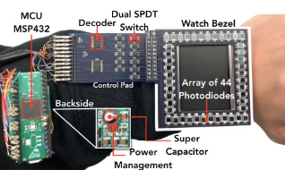
Self-powered gesture recognition with ambient light
LI ET AL. [2]
Custom built array of photodiodes. Always-on recognition of finger gestural inputs. [2]
Picture of the system as a smartwatch. [2]
Focused on the use of their module in accessories, such as smartwatches and glasses.

Slide 9
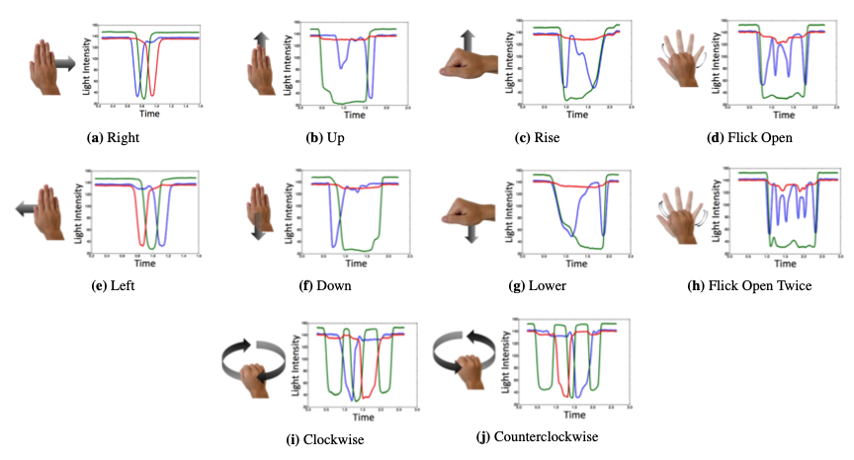
GestureLite
Reusing Ambient Light to Recognize Hand Gestures [3]
MAHINA-DIANA KAHOLOKULA. [3]
Also a custom built densely packed grid of photodiodes. Close range hand gesture sensing. [3] Improvement over LiSense [7].
GestureLite Platform [3]
Very similar approach. Will be looking at presented results for insights.

Slide 10
Gesture recognition is not only used in devices like smartphones and video game consoles. There is great interest in interactive tabletops using gestures. A great amount of ideas are being presented annually at ACM INTERACTIVE SURFACES AND SPACES (ISS) conferences.

Slide 11
Approaches
As technology is evolving we have smaller and more powerful devices consuming least power. In recent years with the introduction of Internet of Things (IoT) and smart devices, we witness persistent integration of computing into our every day life mediums. As the field is undergoing continuous changes, new ways of user interactions are needed.

Slide 12
Approaches
cont.
A great number of researchers have already developed fully working gesture recognition interfaces. As for today, the most common methods of gesture recognition are using cameras.
Initially, camera based approach was considered. However, there are many limitations that come with the use of a camera sensor, as described in the GestureLite paper [3].
In order to overcome the energy consumption and hand gesture recognition challenges, arrays of photodiodes and photovoltaic modules will be considered.

Slide 13
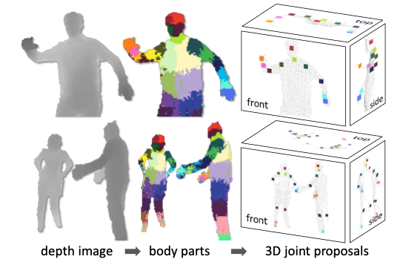
CAMERA BASED APPROACH
Image processing, through motion analysis, and edge detection, can identify and separate the hand region in a photo. However, this kind of algorithms often lead to issues due to surrounding environment being dynamic.
Using a camera to recognise gestures is not a very effective solution. The hand must be in the field of view of the camera for detection to take place.
[4]
Google Images, EB Games.
https://en.wikipedia.org/wiki/Leap_Motion

Slide 14
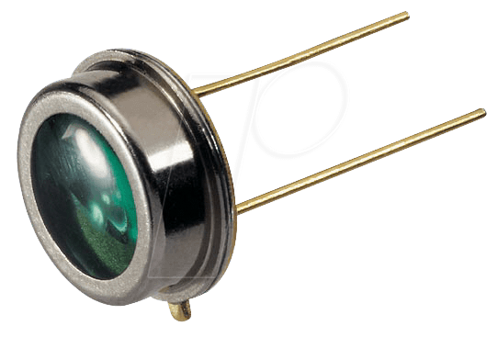
PHOTODIODES ARRAYS BASED APPROACH
Custom built densely packed grid of photodiodes which allows close range hand gesture sensing whilst harvesting power at the same time.
It is an excellent approach, however it is quite complex as it requires custom built array of photodiodes densely packed on a small chip.
Google Images.

Slide 15
PHOTOVOLTAIC MODULE BASED APPROACH
I propose the use of a photovoltaic (PV) module (solar strip) which will, similarly to Li et al. [2], be harvesting power whilst sensing gestures by partially shadowing the PV module. Unlike Li et al. [2] it will sense hand gestures as well.
Moreover, the PV module will be connected to a single board computer which will provide the interactive ability for the table top. This system will read live data from the photovoltaic module in form of dc electricity and detect patterns whilst harvesting energy at the same time.

Slide 16
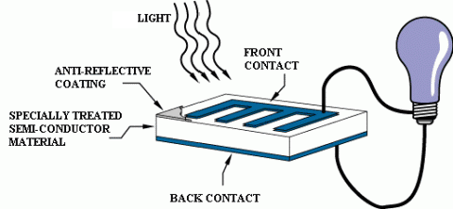
Photovoltaics
In photovoltaics the light is directly converted into electricity at the atomic level as illustrated in the figure. The cells are designed to supply electricity at a certain voltage. And the generated current is directly dependent on how much light strikes the module. [5] When the light above the module is blocked, a certain type of noise is introduced in the data readings of the electric current output.
Illustrated operation of a basic photovoltaic cell. (edited) [5]
From conducted experiments it is clear that based on different hand gestures, such as hand swipes and fist formation, above the photovoltaic module, distinct types of noise are encountered.
Thus, the output data can be fed into a learning algorithm for pattern recognition.

Slide 17
Photovoltaic Approach Summary
This approach has many advantages. It is self-contained, no delays in response time, and requires little to no setup as the PV module is already assembled. A novice user would be able to use the system with minimum effort. However, the ease for the end user comes with challenges during development.
The main challenges with this approach are light conditions. We cannot assume control over the lighting in the environment that the system operates. Different light sources may introduce unpredictable noise generated by level of light, light direction and flickering. Furthermore, the system must recognise equally the same gestures regardless of the user or orientation of the PV module.

Slide 18
Pattern Recognition
In combination with the Photovoltaic module, I will consider several pattern recognition algorithms. K-nearest neighbours. Linear Discriminant Analysis (LDA). Neural networks. I will evaluate the results from each and decide which is more suitable for this project, in terms of accuracy, speed and effectiveness.

Slide 19
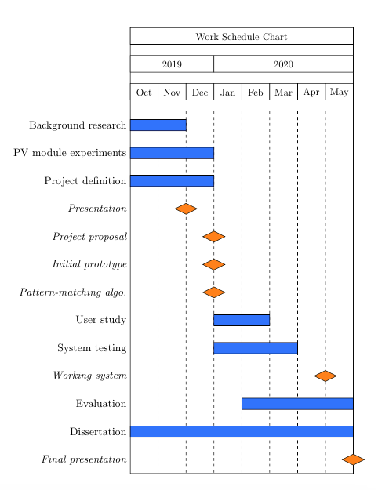
Plan of actions
November 2019, Background research.
December 2019, PV module experiments and Project definition.
January to March 2020, Controlled User study and System testing.
January to May 2020, Evaluation of patter matching algorithms.
May 2020, Final presentation and project submission.

Slide 20
SYSTEM FAILS FOR SOME USERS
SYSTEM FAILS TO SENSE GESTURES BECAUSE OF ORIENTATION
SYSTEM NOT RELIABLE BECAUSE OF LIGHTING CONDITIONS.
Risks
Technical
Design a robust and user agnostic algorithm that will use machine learning for pattern recognition rather than matching a hard-coded signature.
Design a robust algorithm that will understand orientation and make use of that information.
Reduce the noise in the data by reducing the dimensions in the data-set.
LOSS OF DATA
GET INJURED
NOT FINISHING THE PROJECT IN TIME
Personal
Backup project files regularly and use cloud services for data storage.
Approach equipment carefully without touching any live wires.
Follow the above defined plan of actions.

Slide 21

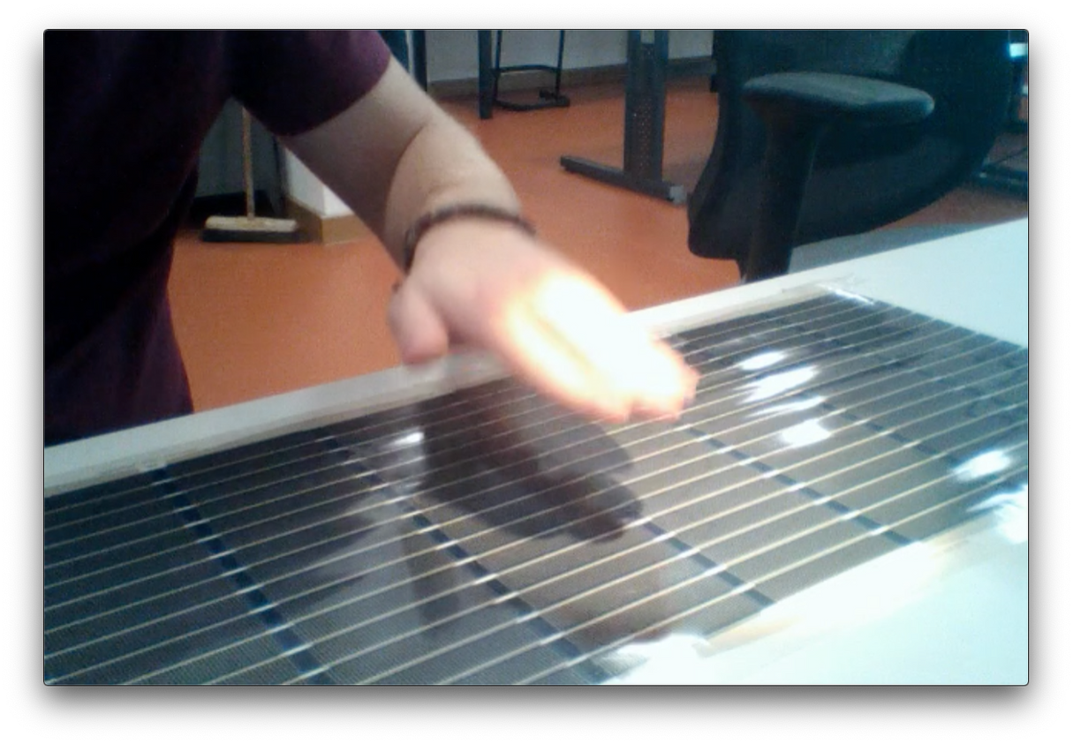
Progress
I have setup the photovoltaic module with a Picoscope device in the maker's lab and conducted several experiments.
Hand gestures such as fist formation, swipes, up/down movement can be detected in a room with just one light source. Later, an additional light source for better shadow definition was used.
Using an additional light source above the hand shows more precise results and allows finger gesture detection.

Slide 22
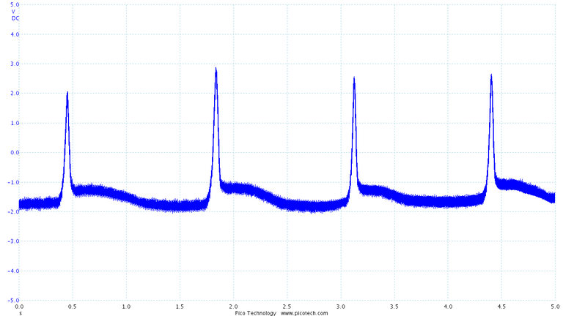
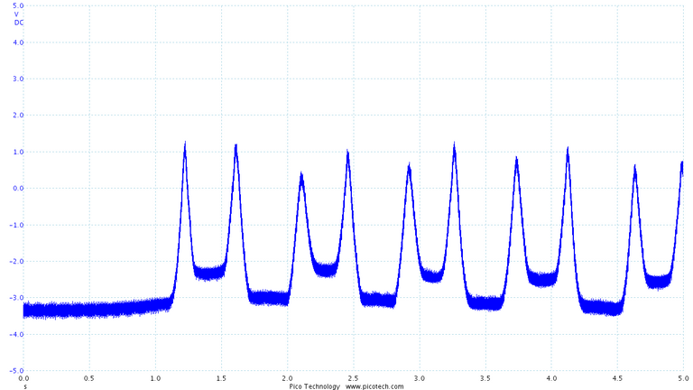
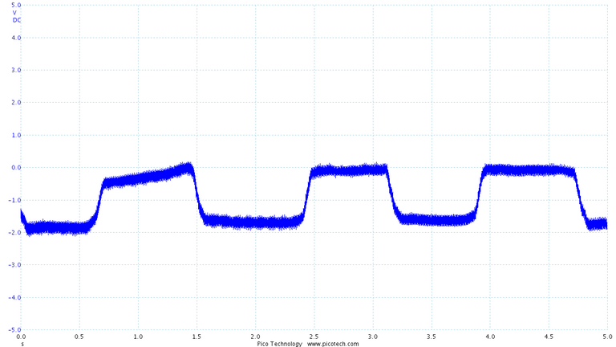
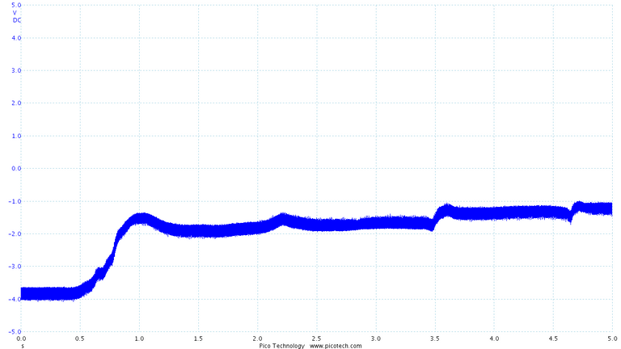
SWIPE ONCE IN ONE DIRECTION
CONTINUOUS SWIPES
FIST FORMATION
FINGER GESTURE
Showing Fingers, starting with one and adding one at a time (increase in noise).
Preliminary Results
Additional light source (lamp).

Slide 23
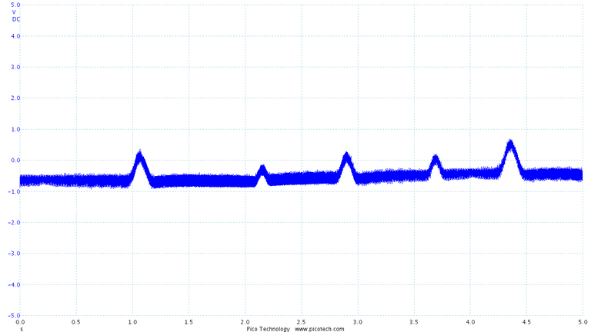
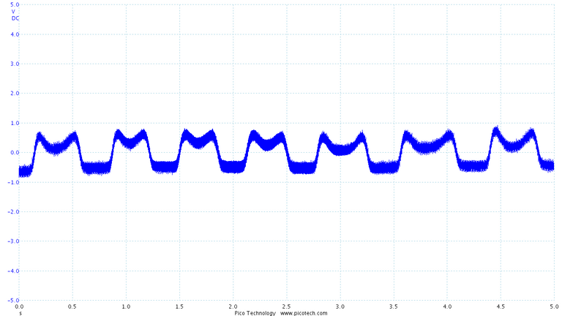
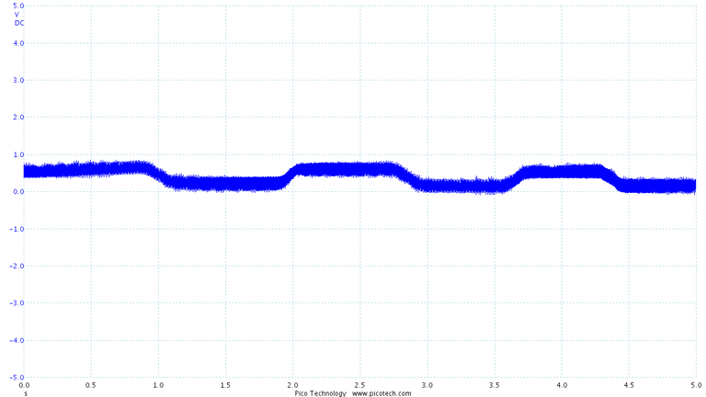
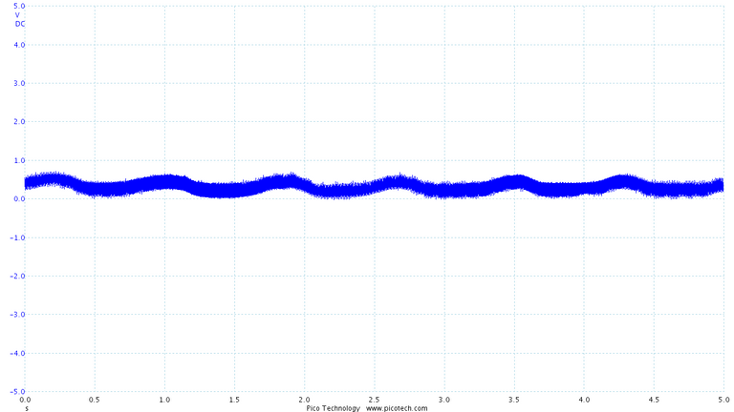
SWIPE ONCE IN ONE DIRECTION
CONTINUOUS SWIPES
FIST FORMATION
UP/DOWN MOVEMENT
Preliminary Results
Just ambient room light.

Slide 24
IOT DEVICES
The introduction of IoT devices brought a huge expansion in technological development.
HUMAN COMPUTER INTERACTION
Summary /
Conclusion
Having computers understand human body language would greatly benefit the users and make human computer interactions more intuitive and effortless.
SELF-POWERED GESTURE RECOGNITION SYSTEM
The produced ambient light in our houses everyday can be captured by photovoltaics and turned back into electric current. The generated current is enough to power small IoT devices [2, 6]. Furthermore, these power harvesters can be used in energy-restricted or battery-free devices for human hand and finger gestures recognition.

Slide 25
[1] R. Nacheva, “Principles of user interface design: Important rules that every designer should follow,” 10 2015
[6] A. Varshney, A. Soleiman, L. Mottola, and T. Voigt, “Battery-free visible light sensing,” in Proceedings of the 4th ACMWorkshop on Visible Light Communication Systems, ser. VLCS ’17. New York, NY, USA: ACM, 2017, pp. 3–8.
[2] Y. Li, T. Li, R. A. Patel, X.-D. Yang, and X. Zhou, “Self-powered gesture recognition with ambient light,” inProceedings of the 31stAnnual ACM Symposium on User Interface Software and Technology,ser. UIST ’18.New York, NY, USA: ACM, 2018, pp. 595–608.
[7] T. Li, C. An, Z. Tian, A. T. Campbell, and X. Zhou, “Human sensing using visible light communication,” inProceedings of the 21st AnnualInternational Conference on Mobile Computing and Networking, ser.MobiCom ’15.New York, NY, USA: ACM, 2015, pp. 331–344
[3] M.-D. Kaholokula, “Reusing ambient light to recognize hand gestures,” 2016
[4] J. Shotton, A. Fitzgibbon, M. Cook, T. Sharp, M. Finocchio, R. Moore,A. Kipman, and A. Blake, “Real-time human pose recognition in partsfrom single depth images,” in CVPR 2011, June 2011, pp. 1297–1304.
[8] W. Lu, Z. Tong, and J. Chu, “Dynamic hand gesture recognition with leap motion controller,” IEEE Signal Processing Letters, vol. 23, no. 9, pp. 1188–1192, Sep. 2016
[5] G. Knier, “How do photovoltaics work?” 2008. [Online]. Available: https://science.nasa.gov/science-news/science-at-nasa/2002/solarcells15
Thank You
References

